Slide 1


CAR BLACK BOX
Powered by

Slide 2
Abstract
The concept of Black Box is mainly heard by us in case of Aeroplanes. The purpose of Black Box can go beyond catastrophe analysis. Also known as an event data recorder (EDR) or Accident data recorder (ADR) the Black Box can be installed in some automobiles to record various events.

Slide 3
Need of this Black Box
By considering today's busy life, everyone wants to reach the destination as soon as possible by ignoring the rules and regulations. By implementing a Black Box which would log critical activities on the car and take appropriate actions in case of rash driving.
As mentioned above the root cause of the negligence in the driving would be meeting the daily schedule and go off duty, or to earn extra money by illegal trips etc... So by implementing the mentioned solution it would be easy to keep track of how the vehicle is being used, handled and control the efficiency of the vehicle.

Slide 4
Requirements
Default Screen
Event capture
Login Screen
Main Menu
View Log
Set Time
Download Log
Clear Log
Change Password

Slide 5
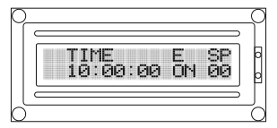
Default screen
When the system is in Operation Mode, it would act like a Dashboard which would show the current time, speed of vehicle and the latest occurred event.
The GEAR UP / GEAR DOWN key used to navigate events(Gears - GN, GR, G1, G2, G3, G4).
Collision key used for Collision event(C).

Slide 6
Event capture
Required events have to be captured and stored in the External EEPROM memory
Every event should have a format as “EVENT TIME” “EVENT SIGNATURE”
“SPEED AT THE EVENT”
The events should be captured real time, no matter which mode you are in
example : You are in download log also event should store in EEPROM memory.

Slide 7
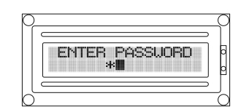
Login screen
On press of the UP or DOWN (User Keys) keys the system should prompt for password
The password would be the combination of 4 presses (User Keys).
Each press should be denoted a "*" symbol
Every wrong entry would, re prompt for password (Max 3 times for every 15 minutes)
After 3 attempt user should be blocked for 2 minutes.
Incomplete key press (pause of 3 seconds) would lead to Default Screen

Slide 8
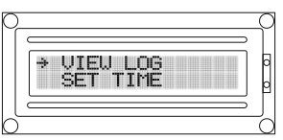
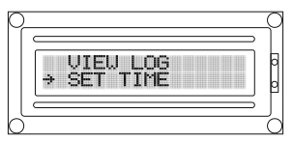
Main Menu
The main menu are
View Log
Set Time
Download Log
Clear Log
Change Password
The main menu should contain 2 option
View Log
Set Time
The UP / DOWN keys are used to navigate
A long press of UP Key should enter the selected menu
A long press of DOWN Key should logout

Slide 9
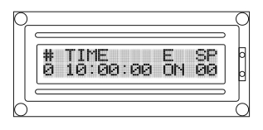
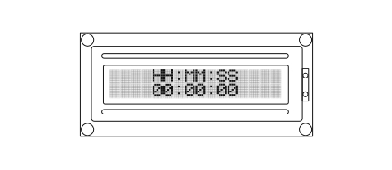
View log
Set time
In this view log whatever events you stored that should display in CLCD.
The UP / DOWN keys are used to navigate.
A long press of DOWN Key should logout.
UP key - Field change
DOWN key - Increment field
A long press of UP Key should set time.
A long press of DOWN Key should logout.

Slide 10
Download log
CLCD - Download log successful.
(Return to Menu screen)
UART - Print all stored Logs.
Clear log
All logs should be Cleared.
CLCD - Clear log successful.

Slide 11
Change password
Read password and read confirm password.
On press of the UP or DOWN (User Keys) keys the system should prompt for password
The password would be the combination of 4 presses (User Keys).
Each press should be denoted a "*" symbol.
A long press of DOWN Key should logout.

